Slide 1

Capstone Project
Hotel Booking EDA Analysis
Team Members Name:
1. Mayank Gupta
2. Dheeraj Patel
3. Vishal Kumar Yadav
4. Khushboo Yadav
5. Rozi Fatma

Slide 2
Content:
Problem Statement
Why Hotel Booking Analysis and its data
Data Summary
Exploring our database
Flow chart and EDA Process
Cleaning of Data and Manipulation
Data Visualization
Challenges faced during data exploration
Conclusions of our analysis

Slide 3

Problem Statements:
In this project, we are analyzing the data of Hotel Bookings which contain different types of hotels data like City hotel and Resort Hotel and there are lots of information included like when will the hotel be booked, cancellation of hotel booking, date of booking, types of customers, length of stay, number of available parking spaces etc.
In the type of Hotel Industry, so many factors help in the growth of the hotel business, which is also volatile.
The main object behind this project is to explore and analyze data to discover important factors that govern the bookings and give insights to hotel management which can perform various campaigns to boost the business and performance.

Slide 4
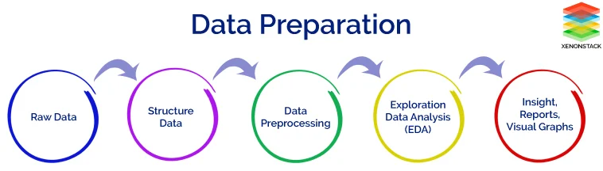

Slide 5
Hotel Booking Analysis and its data?
The purpose of our project was to gather and analyze detailed information about hotels in order to provide insights and estimate the profit.
The majority of Revenue Management research on demand forecasting and prediction issues is conducted in the tourism and travel-related industries.
We have given two hotel data sets. i.e., the resort hotel is one of the hotels, and the city hotel is the other. There are 32 columns and 119390 rows.
With out industry-specific data, it is impossible to completely understand the requirements and peculiarities of the remaining tourism and travel sectors, such as hospitality, cruising, theme parks, etc. To help overcome this restriction, two hotel datasets with demand data are given.
Hotels will be able to identify the issue that is causing customers to cancel their bookings, as well as the reason for the cancellations, by utilizing the predictive
It would be fantastic if the hotel management team could identify the root cause and develop a better strategy.
The goal of our project was to collect and analyze detailed hotel information in order to provide insights and estimate profit.

Slide 6
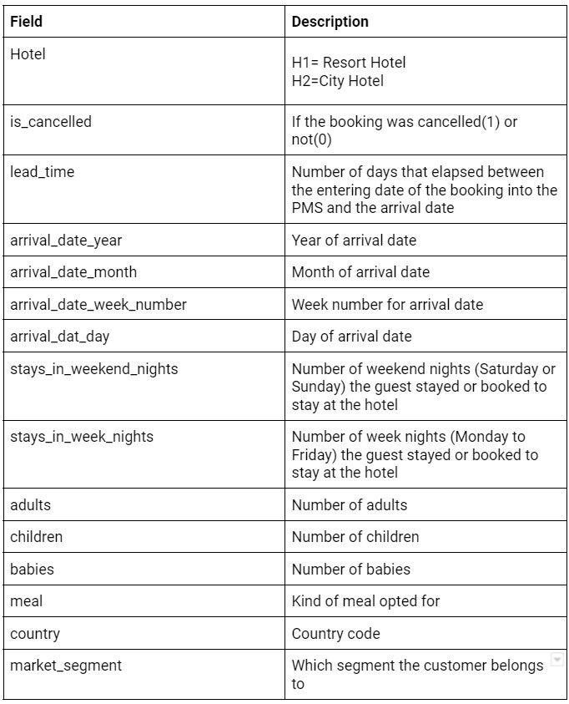
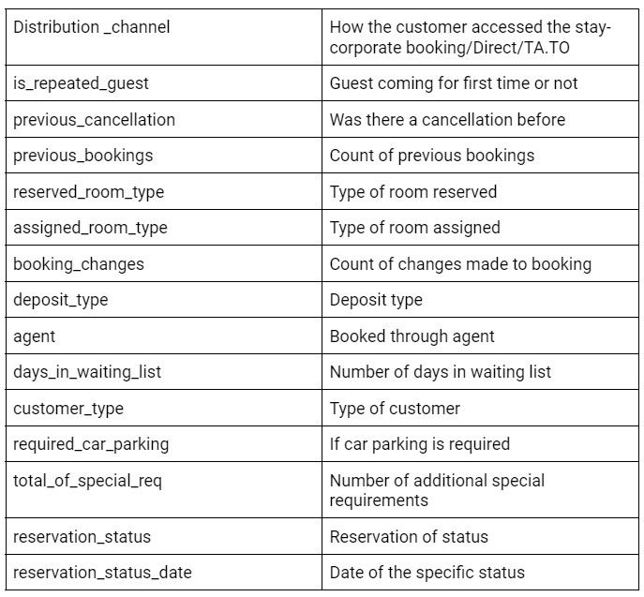
Data Summary:

Slide 7
Data Collection and Understanding:
After collecting data it’s very important to understand your data. So we had hotel booking which has 119390 rows and 32 columns. So, let’s understand the columns.
Data Description:-
Hotel : Different type of Hotels.
is_canceled : The value indicates whether or not the reservation has been cancelled.
lead_time : How far in advance the reservation was made
arrival_date_year : Year of customer arrival.
arrival_date_month : Which month of the year did the customer visit
arrival_date_week_number: Which week of the year
arrival_date_day_of_month :The month in which the customer visited the hotel.

Slide 8
stays_in_weekend_nights : Customer stayed or booked to stay in hotel during weekend nights.
stays_in_week_nights : The customer stayed or planned to stay in a hotel on a weekend night.
adults : Number of adults
children : number of children.
babies : Number of babies.
meal : Type of meal booked.:
country : Country of origin of customer.
market_segment : where the bookings came from.
distribution_channel : Booking distribution channel. The term “TA” means “Travel Agents” and “TO” means “Tour Operators” .
is_repeated_guest : Value indicating if the booking name was from a repeated guest (1) or not (0).
previous_cancellations : The number of previous bookings that the customer cancelled prior to the current booking.
previous_bookings_not_canceled : Number of previous bookings that were cancelled by the customer prior to the current booking.
reserved_room_type : The number of previous bookings cancelled by the customer prior to the current booking.
assigned_room_type : The code for the room type assigned to the booking. Because of this, the assigned room type may differ from the reserved room type.
*booking_changes *: Number of changes/amendments made to the booking from the moment the booking was entered on the PMS.

Slide 9
deposit_type : Indicates whether or not the customer paid a deposit to secure the reservation.
agent : The ID of the travel agency that made the reservation.
company : ID of the company/entity that made the reservation or is responsible for paying the reservation.
days_in_waiting_list : The number of days the reservation was on the waiting list before being confirmed to the customer.
customer_type : Booking type, assuming one of four categories.
*adr *: The average daily rate is calculated by dividing the total number of staying nights by the sum of all lodging transactions.
required_car_parking_spaces : The number of parking spaces needed by the customer.
*total_of_special_requests *: The number of customer special requests (e.g. twin bed or high floor).
reservation_status : Last reservation status in one of three categories: Canceled - the customer cancelled the reservation; Check-out: the customer checked out of the hotel. No show: the customer did not check in to the hotel and informed the hotel of the reason.
reservation_status_date : The date on which the most recent status was set. This variable, in conjunction with the Reservation Status, can be used to determine when the booking was cancelled or when the customer checked out of the hotel.

Slide 10
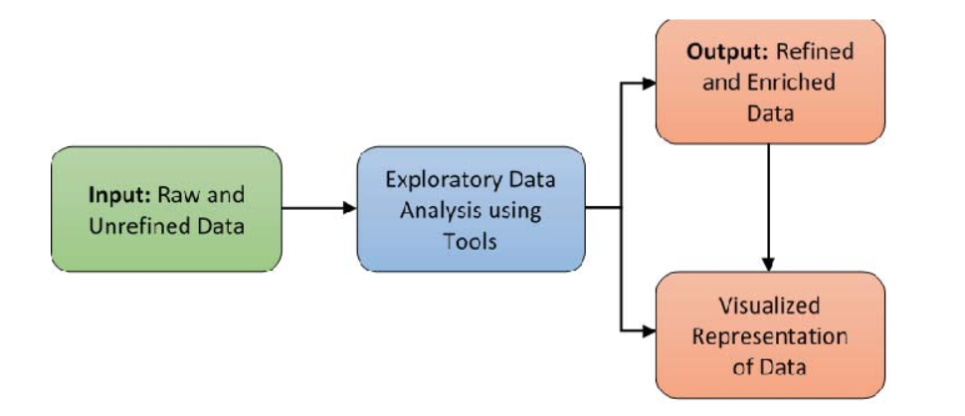
Flowchart and EDA Analysis

Slide 11
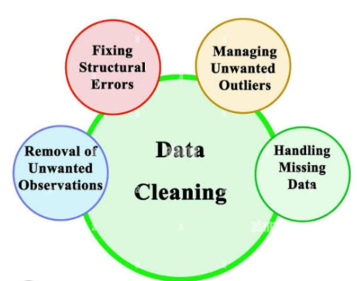
Cleaning of Data and Manipulation

Slide 12
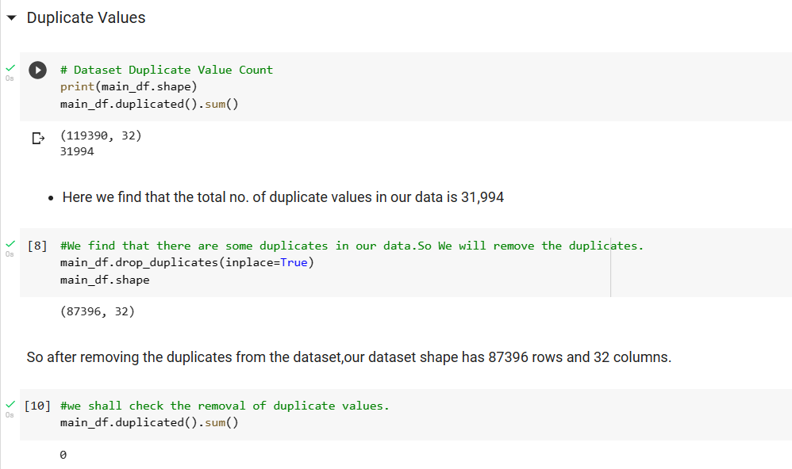
Removing of Duplicate values

Slide 13
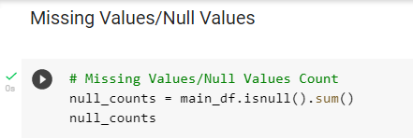
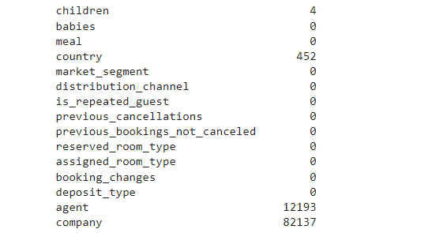
Dealing with Null Values

Slide 14
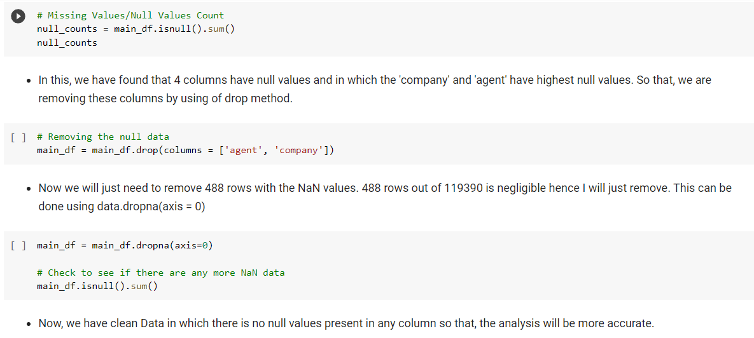
Dealing with Null Values Contd…

Slide 15
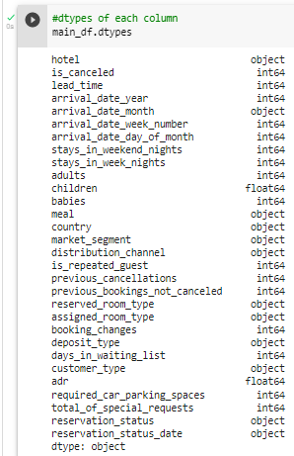

Converting Data Type

Slide 16
DATA VISUALIZATION
Let’s take some insights from our data
1 What is the count of each type of Hotels ?
2 Which of the two hotels is preferred by customers, and in which year most hotels were booked?
3 When the hotel gets more guest i.e., in weekdays or weekends?
4 Which month is the most profitable for hotel bookings?
5 What is the booking rate according to the population?
6 Which form of distribution do customers prefer most?
7 Which type of hotel is mostly preferred by adults , children or babies?
8 Which type of hotel bookings are mostly cancelled?
9 Which hotel produces maximum revenue?
10 The maximum number of guests are from which country?
11 Which distribution route and market segments has given adr the most boost in terms of revenue?
12 In which month do the hotels have the highest ADR?
13 What is the reason for cancellation of bookings?
14 What is the number of repeated customer in hotel bookings?
15 Does a longer waiting period result in cancelled bookings?

Slide 17
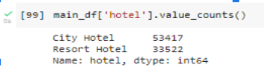
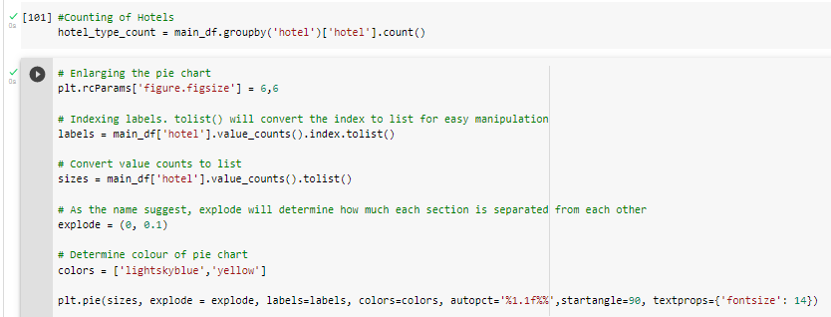
What is the count of each type of Hotels ?

Slide 18
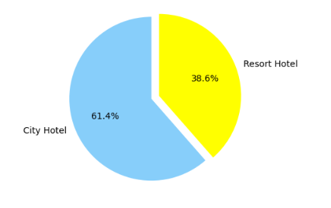
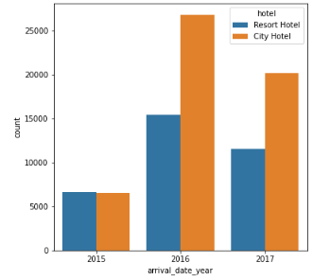
Data Visualization of hotel type
Which of the two hotels is preferred by customers, and in which year most hotels were booked?
We have found there are two types of hotel in the given dataset.
It seems that a huge proportion of hotels was city hotel. Resort hotel tend to be on the expensive side and most people will just stick with city hotel.
The most of the hotels are booked in the year 2016

Slide 19
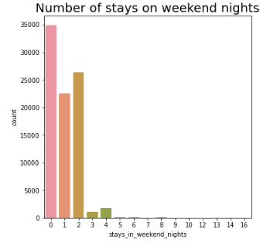
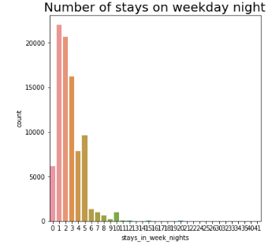
Data Visualization
When the hotel gets more guest i.e., in weekdays or weekends?
What do we see this time?
It seems that majority of the stays are over the weekend’s night.

Slide 20
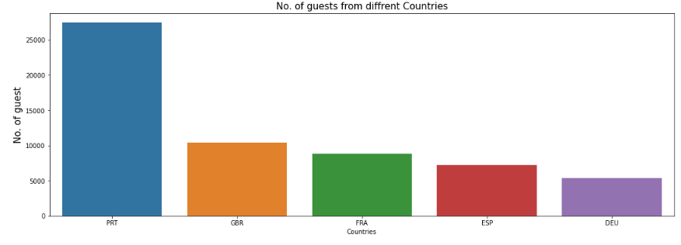
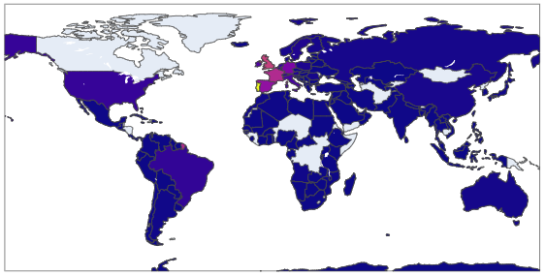

Data Visualization
The maximum number of guests are from which country?
Observation : More than 25000 people, or the majority of the attendees, are from Portugal.
Abbreviations for nations:
PRT- Portugal, GBR- United Kingdom, FRA- France, ESP- Spain, DEU - Germany

Slide 21
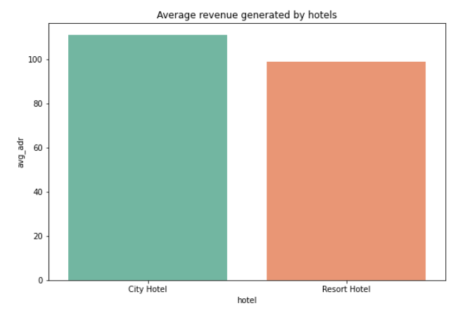
Data Visualization
Which hotel produces maximum revenue?
According to the above figure, City hotel has more average revenue than resort hotel

Slide 22
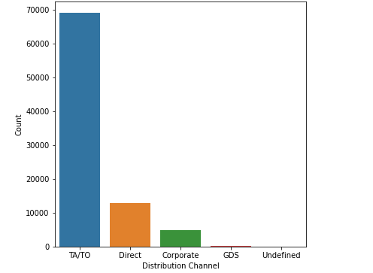
Data Visualization
Which form of distribution do customers prefer most?
TA/TO are the customers' chosen distribution channels.
In order to grow their business, hotels might partner with these agents and operators or promote using them as a medium.

Slide 23
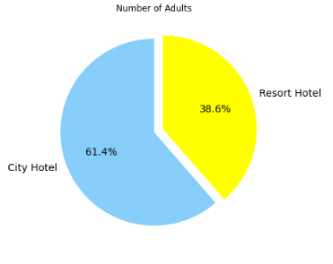
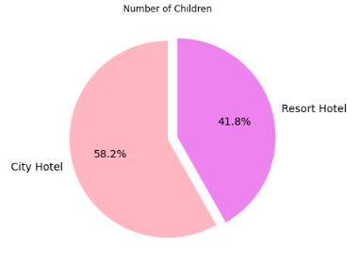
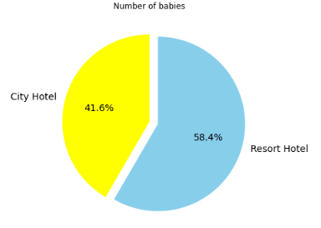
What is the booking rate according to the population?
Resort hotels are better choice for large families having babies.
It seems that majority of the visitors who travel in pair, prefer City hotels.

Slide 24
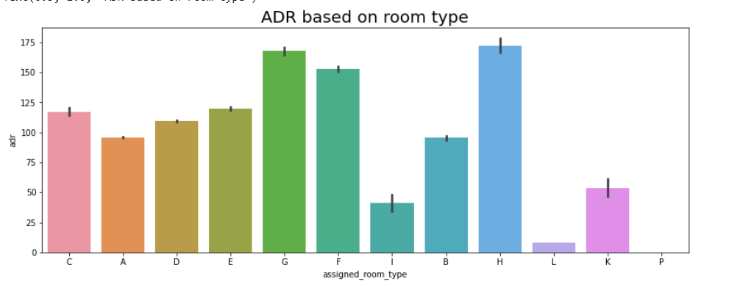
Data Visualization
Which room type has the highest average daily rate?
H type has the highest Average daily rate followed by G type and F type

Slide 25
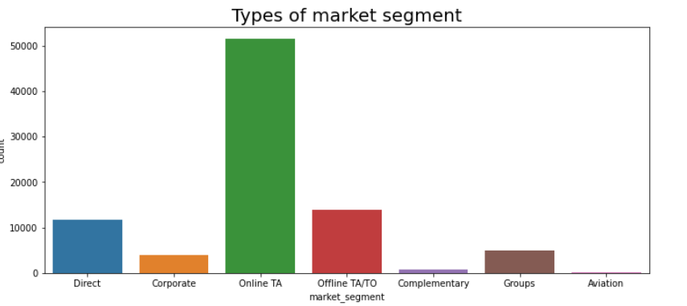
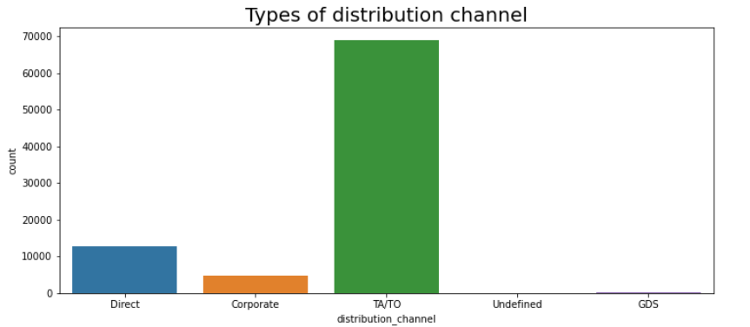
Data Visualization
From which Channel the guest come in the hotel location?
Majority of the distribution channels and market segments involve travel agencies (online or offline).
We can target our marketing area to be on these travel agencies website and work with them since majority of the visitors tend to reach out to them.

Slide 26
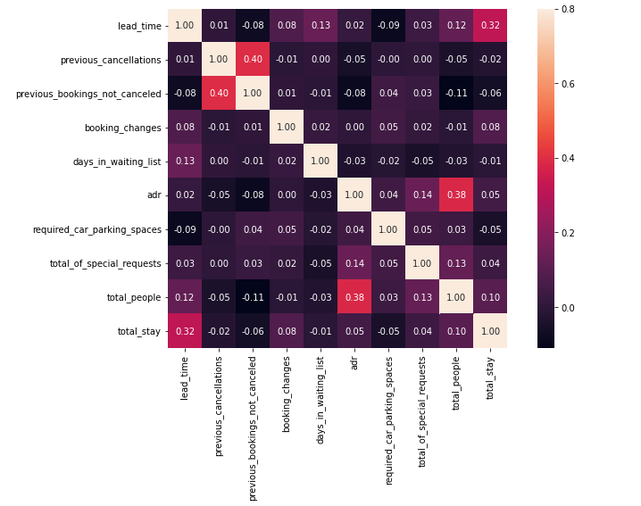
Data Visualization
What will give after finding the correlation between the numerical data ?
Total stay length and lead time have slight correlation. This may means that for longer hotel stays people generally plan little before the the actual arrival.
adr is slightly correlated with total_people, which makes sense as more no. of people means more revenue, therefore more adr.

Slide 27
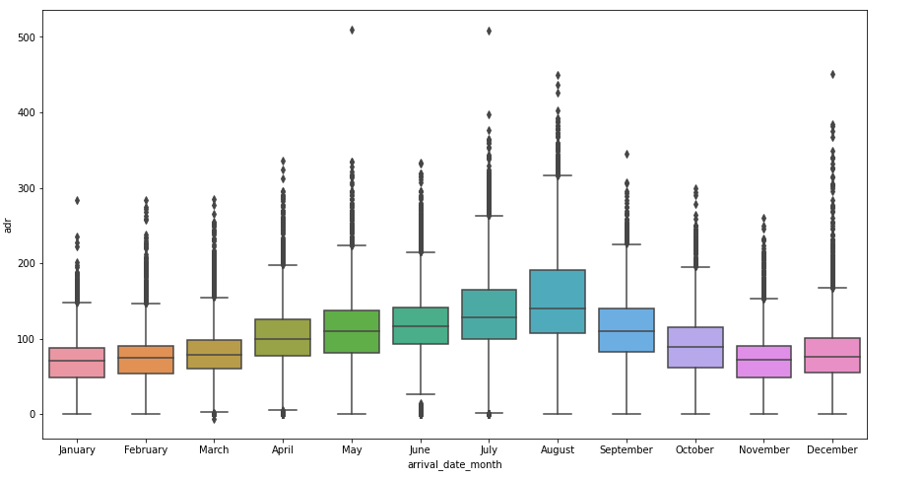
Data Visualization
Which month generated more revenue across the year 2015, 2016, and 2017?
Avg adr rises from beginning of year upto middle of year and reaches peak at August and then lowers to the end of year. But hotels do make some good deals with high adr at end of year also.

Slide 28
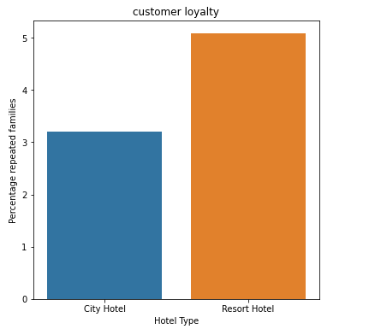
Data Visualization
Which hotel has a higher rate of returning customers?
From the above graph it is clear that highest rate of returning customers are from the resort hotel.

Slide 29
Conclusion
With this whole analysis we found the following points:
Resort hotels are more expensive compared to the City hotels. A huge portion of the hotels is City hotel.
Resort hotels are better choice for large families.
It seems that majority of the visitors who travel in pair, prefer City hotels.
In the year 2016, highest hotel bookings were registered.
In the month, July to August highest hotel bookings were found.
It seems that majority of the stays are over the weekday night.
In the hotel bookings we have found that a huge number of visitors are coming from western europe, namely France, UK and Portugal are among the highest.
Majority of the distribution channels and market segments involve travel agencies (online or offline).
We observed that the high rate of cancellations is due to 'no deposit' policy.
We need to focus on that customers who visited first time in the hotel but not booking the hotel again.

Slide 30


